Slide 1
Company Visual Presentation
Student’s Name
Institutional Affiliation

Slide 2
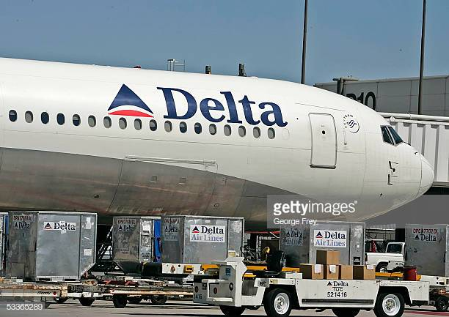
Company Knowledge
Became Delta airlines in 1930s.
It operates in different states namely;
Florida
2. Arkansas
3. Mexico and
4. California
Privately owned.

Slide 3
My Career Objectives
To pursue my ticketing agent career.
Work with a supportive organization.
Grow my career.
Work with an organization offering opportunities.

Slide 4
Accomplishment
Airline Ticket Agent, Western airlines handling;
Customers’ complaints and inquiries.
Answers the customers’ questions courteously regarding booking tickets.
Announce to customers the flight status and notifying them about any changes.

Slide 5
Continuation of Accomplishment
Ticket agent, Orlando International Airport handling;
1. Booking arrangement for the clients who make booking over the phone and through email
2. Checking and tagging the customers’ luggage.
3. Manage the company’s booking database.
4. Security of the customers’ luggage.

Slide 6
Traits and Skill Set
Traits
Hardworking
2. Courteous
Skill Sets
Issuing tickets
Handling cash transactions
3. Answering customer queries

